Slide 1
01
Introduction
02
Conduct backtesting for multiple assets and strategies
Input Example
03
Output Example
(Assumption)
Use 2673.45 dollar plus transaction cost to buy one unit of S&P500 index if the price of it equals 2673.45

Slide 2


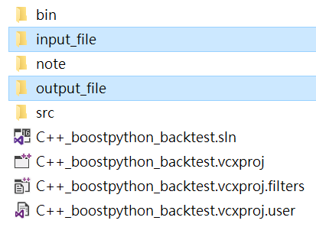

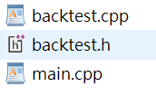


Introduction
Framework
fopen path of program
Source code
https://github.com/lfq361234/Cbacktest/tree/master

Slide 3
Introduction
Negative number➔ Long
Positive number ➔ Short
Price and strategy➔ form_strategy.csv
Parameter setting➔ parameter.csv
Input
fopen path of program
Source code
➔
output

Slide 4
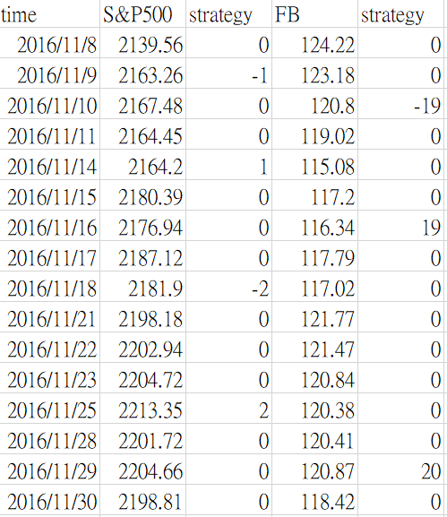
Input Example
form_strategy.csv
parameter.csv
Flexible adjustment any parameter
dataFreq represents how many data points for each asset during a year

Slide 5
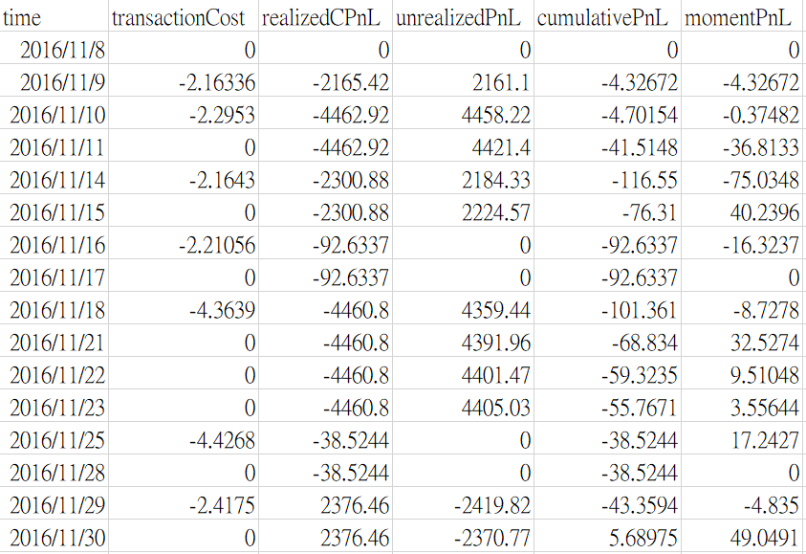
Output Example
backtest.csv
C++ only output some digits for double in file output, so the last digit of number is not precise in csv file

Slide 6
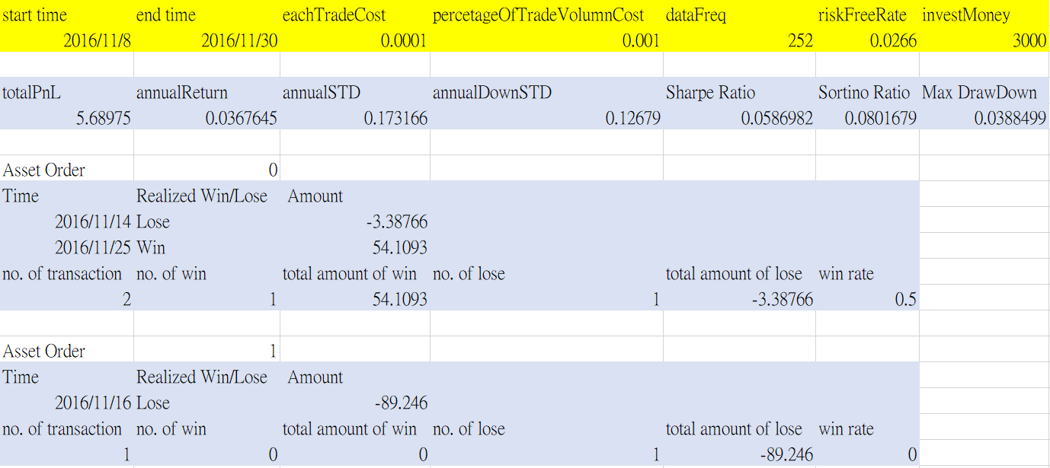
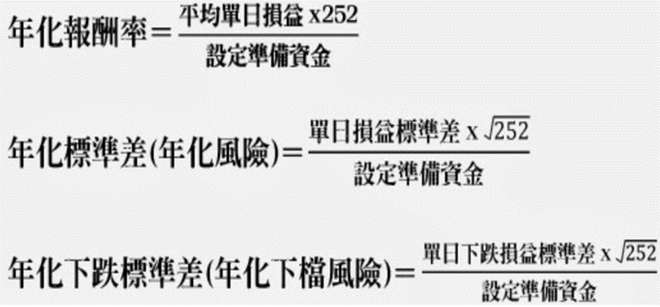
Output Example
evaluation.csv
For annualDownSTD:
Assume minimum acceptable return is equal to riskFreeRate
Use minimum acceptable return to calculate target average daily PnL
Use target average daily PnL to calculate downside STD of daily holding PnL then annualizing it with investMoney
Asset Order1: FB still has some unrealized position that is not taken account into Win/Lose analysis

